Slide 1

Migration of C/C++ Cryptographic Algorithms to Rust, Demonstrating Memory Safety
Presented By:-​
Parth Shitole(2021A7PS2907G)
Prateek Chitre (2021A7PS2841G) ​
Ananth (2021A7PS2647G) ​ ​
Niranjan Rajeev (2021A7PS3055G)

Slide 2
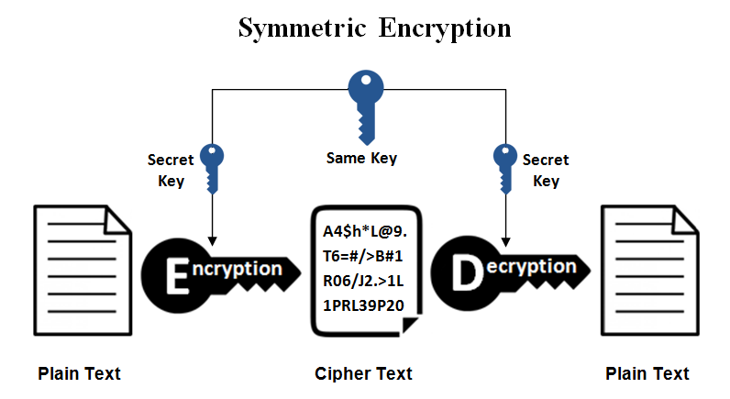
What is encryption and why do we need it?
Whenever we are sending a message between a sender and a receiver it goes through an unsecured channel unless there is any dedicated link/line between them.
Hence it becomes crucial to encrypt the message using keys before sending it directly. After encryption, the message converts to cipher text.
What is significance of symmetric in symmetric encryption?
The key used to encrypt on the sender’s end is the same as the key which is used to decrypt or decipher the message on the receiver’s end.This means that to decrypt information, one must have the same key that was used to encrypt it.

Slide 3
Biggest issue with Symmetric Key Encryption
Key exchange
We also have to provide receiver with the key, otherwise it won’t be able to decrypt the message.
Providing the key along with the message is meaningless because in this case the the purpose of encryption is nullified since the key attached with the message can be used to decrypt the message.
One of the best solutions to the above problem is Diffie-Hellman Key Exchange.

Slide 4
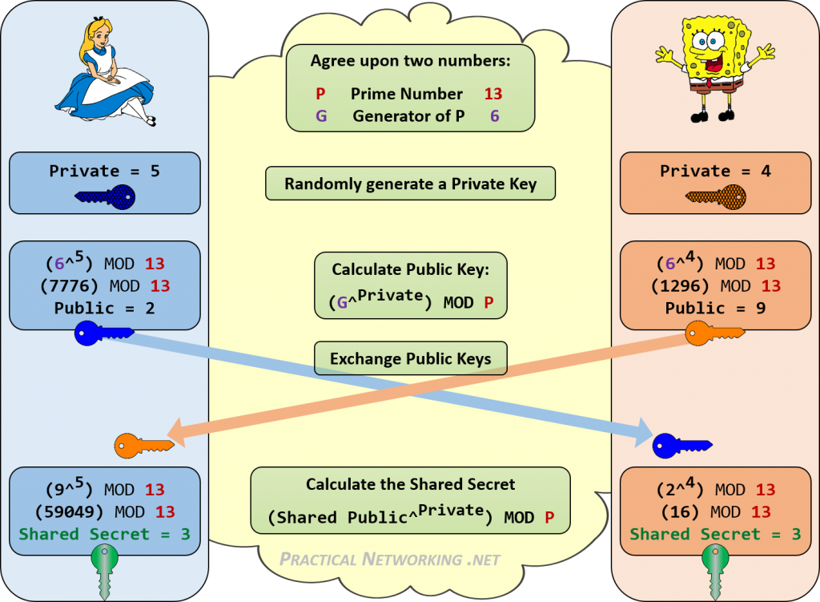


Alice
Bob

Slide 5
How does the algorithm work?
Step 1: Alice and Bob get public numbers P = 23, G = 9
Step 2: Alice selected a private key a = 4 and Bob selected a private key b = 3
Step 3: Alice and Bob compute public values
Alice: x = (9^4 mod 23) = (6561 mod 23) = 6
Bob: y = (9^3 mod 23) = (729 mod 23) = 16
Step 4: Alice and Bob exchange public numbers
Step 5: Alice receives public key y =16 and Bob receives public key x = 6
Step 6: Alice and Bob compute symmetric keys Alice: ka = y^a mod p = 65536 mod 23= 9 Bob: kb = x^b mod p = 216 mod 23 = 9
Step 7: 9 is the shared secret.

Slide 6
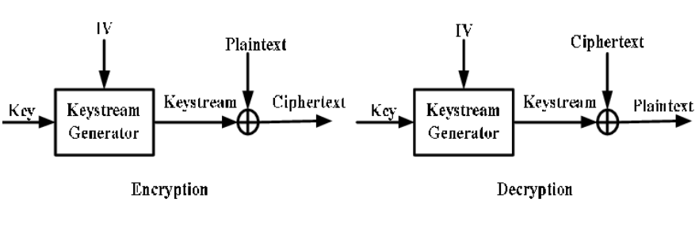
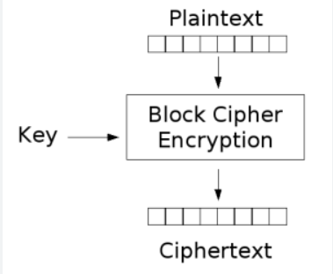
Encryption Types
There are 2 types of Symmetric key encryption methods:
Stream ciphers
Block ciphers
Ciphers depend on 3 important components:-
Plaintext - The message that is to be encrypted.
Keystreams - A set of random or pseudo random characters, combined with the plaintext for encryption.
Ciphertext - This is the encoded message.

Slide 7
Stream Ciphers: -
A stream cipher is an encryption technique that works bit by bit to transform plain text into cipher text that's unreadable to anyone without the proper key. Stream ciphers are linear, so the same key is used for encryption as well as decryption.eg the RC4 algorithm is a stream cipher.
There are 2 main categories of stream ciphers:-
Synchronous stream ciphers: A synchronous stream cipher is a stream cipher, in which the keystream is generated independently of the plaintext and of the ciphertext. The keystream is usually produced by a pseudorandom generator.The characters in keystream can be numbers or characters.
Self-synchronising stream ciphers: uses several of the previous N ciphertext digits to compute the keystream.

Slide 8
Block Ciphers:
A block cipher is a method of encrypting data in blocks to produce ciphertext using a cryptographic key and algorithm. The block cipher processes fixed-size blocks simultaneously, as opposed to a stream cipher, which encrypts data one bit at a time. Most modern block ciphers are designed to encrypt data in fixed-size blocks of either 64 or 128 bits.e.g AES,DES,3DES.

Slide 9
RSA
In RSA, we have two large primes p and q, a modulus N = pq, an encryption exponent e and a decryption exponent d that satisfy ed = 1 mod (p - 1)(q - 1). The public key is the pair (N,e) and the private key is d.
To encrypt a message M, compute C = Me mod N.
We want to show M = C^{d} mod N, i.e., that we can decrypt by raising the ciphertext C to the d power and reducing the result modulo N. But first we must take a slight mathematical detour.
Two positive integers m and n are said to be relatively prime if they have no common factors other than 1. For example, though both 10 and 9 are composite numbers, they are relatively prime, since they have no factor (other than 1) in common.

Slide 10
For a positive integer n, define φ(n) to be the number of integers less than n that are relatively prime with n. For example, φ(12) = 4, since only 11, 7, 5 and 1 are less than 12 and relatively prime to 12, while φ(7) = 6. In fact, for any prime number p we have φ(p) = p - 1.
Suppose the prime factorization of n is given by n = p₁^{k}₁ p₂^{k}₂ ... p_{r}^{k}_{r} Then it can be shown that φ(n) = n (1 - 1/p₁) (1 - 1/p₂) ... (1 - 1/p_{r}) Note that for the RSA modulus N = pq this result implies φ(N) = (p - 1)(q - 1)

Slide 11
The final mathematical result we need is Fermat's Little Theorem. This theorem is usually stated as
Fermat's Little Theorem: If p is prime and p does not divide x, then x^{p - 1} = 1 mod p
However, a generalization of Fermat's Little Theorem (sometimes known as Euler's Theorem) is more directly applicable to RSA. This theorem states that
Euler's Theorem: If x is relatively prime to n then x^{φ(n)} = 1 mod n
Now back to RSA decryption. We want to show that M = C^{d} = (Me)^{d} = M^{ed} mod N.
Recall that ed = 1 mod (p - 1)(q - 1). Also, since N = pq, as noted above, we have φ(N) = (p - 1)(q - 1) and it follows that ed = 1 mod φ(N).

Slide 12
Then by the definition of "mod", there is some k such that ed - 1 = kφ(N). We now have M^{ed} = M^{(ed - 1) + 1} = M M^{ed - 1} = M M^{kφ(N)} mod N
Finally, Fermat's Little Theorem (in the form of Euler's Theorem) can be applied to yield the desired result M^{ed} = M (M^{k})^{φ(N)} = M mod N = M.

Slide 13
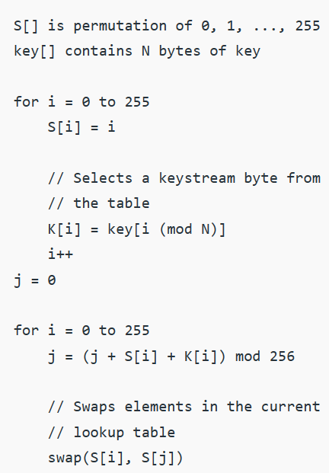
RC4 Encryption Algorithm
RC4(Rivest Cipher 4) is a stream cipher algorithm that supports variable key length. It can encrypt and decrypt one byte (or more) at a time. The key input goes into a pseudorandom bit generator that produces an 8-bit keystream, which is combined with the plaintext/ciphertext one byte at a time. It has 2 main parts:-
Key Scheduling Algorithm(KSA): A temporary vector K (size 256 bytes) is created using the variable length key. The entries of S are initially filled with values from 0 to 255 in that order. Now, K is used to produce an initial permutation of S.

Slide 14
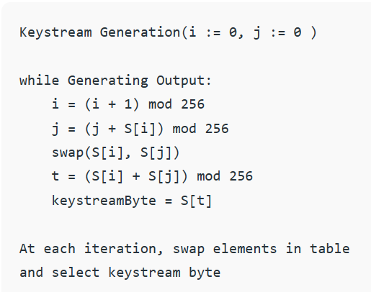
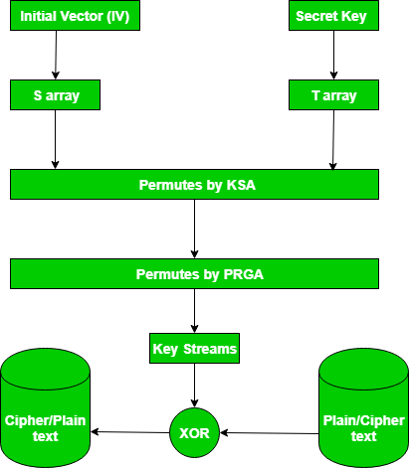
2. Pseudo random generation algorithm(PRGA): It is used to generate the keystream byte from state array (S) after another permutation. An additional permutation is applied to S for every successive byte of the keystream that is generated.
Once the keystream has been generated, XOR operation is performed for encryption/decryption.
An overview of the entire process is given in the figure to the right.

Slide 15
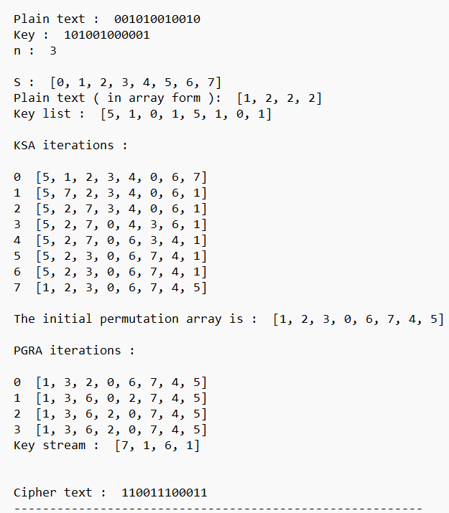
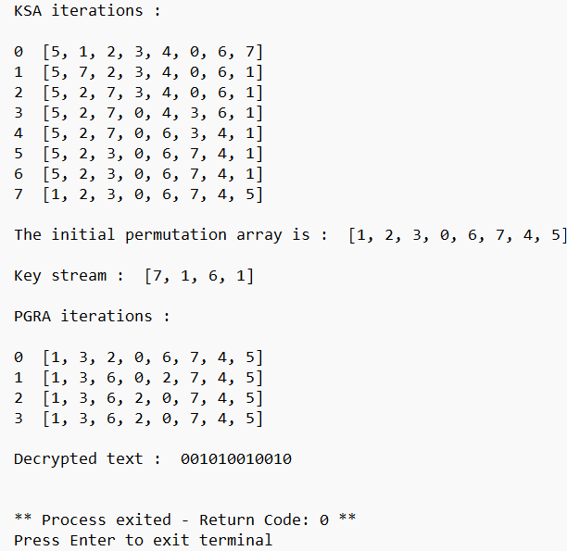

Slide 16
Advantages of RC4 algorithm:-
It is fast and efficient, which makes it appropriate wherever speed and efficiency are paramount.
It supports variable key size making it flexible for different security requirements.
It is easy to implement, both in terms of software and hardware.
Disadvantages of RC4 algorithm:-
RC4 has several known vulnerabilities due to its relatively simple design, which can be exploited by hackers for eg. there is a bias in the very few bytes of the keystream, which may be used to obtain the key.
Maximum key size of RC4 is 2048 bits, which may not be sufficient for applications that require higher security.

Slide 17
Memory leak in functions in c
Unfreed memory location: Can leak values
Dangling references Not in rust unlike in c
In C, manual memory management exposes programs to memory leaks, which occur when allocated memory is not properly freed, potentially leaking sensitive data and impacting performance. Dangling references, where pointers still point to deallocated memory, can lead to crashes and security vulnerabilities. Rust, in contrast, offers a safer approach to memory management through its ownership and borrowing system. It automatically handles memory deallocation, reducing the risk of memory leaks and unfreed memory locations. Additionally, Rust's strict ownership rules eliminate the possibility of dangling references, ensuring that all references are valid and enhancing both security and stability.

Slide 18
Buffer Overflow
Example: Stack Functions in C(input) Do not check the length of input. If buffer length is less than input length, ......
Buffer overflows are a common source of security vulnerabilities in C++ programs due to the language's manual memory management. Developers must be meticulous in their code to prevent buffer overflows.
Rust is designed with a strong focus on memory safety and security. It has features like strict memory management, ownership, borrowing, and lifetimes that help prevent common programming errors, including buffer overflows.
In Rust, many common buffer overflow vulnerabilities are practically eliminated by the compiler, as it enforces strict rules to prevent unsafe memory access.

Slide 19
Reverse engineering is difficult in rust
Executable to source code: reverse engineering. easier in c. difficult in rust due to lack of symbolic information and type system.
Compile time checks and modifications made by rust: type system implemented, Symbolic info eliminated.
Reverse engineering, extracting source code from executables, is typically easier in C than Rust due to C's symbolic information and less strict type system. C code can be reverse-engineered with relative ease. In contrast, Rust's strong type system and lack of extensive symbolic information make reverse engineering more challenging. Rust's compile-time checks and optimizations further obfuscate the code, making it harder to decipher. This enhanced security comes at the cost of making the reverse engineering process more difficult due to the type system's strictness and the removal of symbolic information, bolstering Rust's defense against code analysis.

Slide 20
Attacks
Cache Side Channel Attack(Cache Poisoning)
A cache side-channel attack works by monitoring security critical operations such as AES T-table entry or modular exponentiation or multiplication or memory accesses.The attacker then is able to recover the secret key depending on the accesses made (or not made) by the victim, deducing the encryption key. Also, unlike some of the other side-channel attacks, this method does not create a fault in the ongoing cryptographic operation and is invisible to the victim.
In 2017, two CPU vulnerabilities (dubbed Meltdown and Spectre) were discovered, which can use a cache-based side channel to allow an attacker to leak memory contents of other processes and the operating system itself.

Slide 21
How Rust Mitigates Side Channel Attack
Rust eliminates common sources of undefined behavior, reducing the risk of side-channel attacks leveraging such vulnerabilities.
Rust's strict type system enforces proper data handling, minimizing the chance of unintentional data leaks.
Rust encourages the use of constant-time cryptographic implementations, mitigating timing-based side-channel attacks.

Slide 22
Thank You

